Slide 1
When Sleep Hygiene is Not Enough
Using hypnosis for sleep problems

Slide 2
Before considering hypnosis:
Exclude physical problems e.g. heart failure, sleep apnoea etc
Exclude drug related effects, caffeine, beta blockers, SSRIs etc
Exclude contraindications for hypnosis
Measure scores for anxiety and depression
Use in conjunction with sleep hygiene advice
Keep eyes open when there are anxious thoughts at night

Slide 3
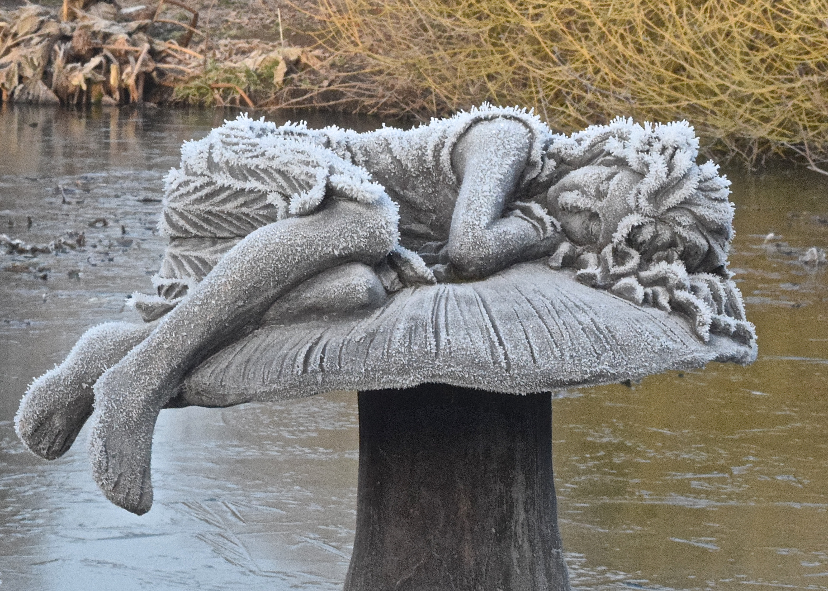
Hypnosis for Sleep Problems
Primary Insomnia
Secondary Insomnia
Nightmares/night terrors
Sleep walking

Slide 4
Primary Insomnia
If patients are naturally short sleepers then hypnosis is unlikely to make a significant change.
Use hypnosis to explore the ‘why now” aspect of their presentation
Aim to restore the ‘it doesn’t bother me’ status

Slide 5
Secondary Insomnia
Assess if patient suitable for hypnosis
Take a brief history:
  when did it start?
  What was happening at the time?
  Have you had spells like this before?
Some measure of psychological co-morbidity HADs BDI, GAD7 PHQ9 etc
Explain hypnosis and show fMRI scans
Consent

Slide 6
Secondary Insomnia
Hypnotize:
  Suggest a relaxing induction
    Don’t be surprised if they fall asleep!!
Explore the beginnings of the problem
  Computer search
  Problem room etc
Empathize where appropriate
Resolution:
  Older wiser self
  Room of forgiveness
  Delete problem etc

Slide 7
Secondary Insomnia
Re-programme the sleep centre
Mentally rehearse sleeping through the night
Ego-strengthening
Post hypnotic suggestion
Dehypnotize
Post hypnosis chat
Encouraged to practise self hypnosis – perhaps with specific ‘getting off to sleep’ mantra or technique e.g. circle on blackboard (Kraft & Kraft)

Slide 8
Case History: Clifford
56 yr old man 5 month history of poor sleep and feeling ‘down in the dumps’
Seemed to start when his wife’s menopause at its height
Remembers being woken suddenly when she threw the covers off
Hadn’t slept well since and very unsettled

Slide 9
Clifford
Hypnosis: walking in the woods with his dog
Searched back to the night it started.
‘It’s the feeling I can’t get rid of’
Did an affect bridge type search to the origin of the feeling
Tears
New boy at boarding school: initiation ceremony!!
Used a video technique to resolve feeling and moved the memory into his personal museum.
Disconnected those links from his sleep centre and reprogrammed it.

Slide 10
Clifford:
By the next session he was sleeping well again and those uneasy feelings had gone.
Ego strengthening
Discharged

Slide 11
Nightmares/night terrors
Hypnotize
Go into sleep centre and look at the sleep record – see what triggers the nightmare
Switch on dream control
Isolate/disconnect/resolve the cause
Create a store of pleasant happy dreams and connect to the dream pathway
Ego strengthening
Post hypnotic suggestion

Slide 12
Harry
11 year old lad – just started at secondary school
Began having nightmares and developed absences/fainting at other times
EEG excluded epilepsy
Explored under hypnosis:
Dream was of huge chickens with long sharp beaks stabbing at him
These images were intrusive during the day but disappeared if he fainted!
Nightmares started after watching ‘Murder on the Orient Express’
Explained he was in charge of his dreams and could frighten the chickens away if he shouted at them – mentally rehearsed this in hypnosis.

Slide 13
Harry
Also deleted the video of the film from his memory.
He had no more nightmares/absences/faints after that one session

Slide 14
Sleepwalking
Most cases don’t present for treatment and usually resolve spontaneously as time goes on.
If they do present for treatment – ‘why now’?
Direct suggestion usually enough for resolution

Slide 15
Mark 17yrs
Had been sleepwalking all his life and never a problem
One night put his hand through a glass door and cut a tendon – needed plastic surgery
Explored under hypnosis: no identifiable cause
  Does it need to continue??
Sleep control reprogrammed
Relaxation technique with suggestions that he would sleep well without any disturbance
No further sleepwalking

Slide 16
Martyn 23
Problem didn’t surface until he moved in with his girlfriend
She noticed that he would wake with a start – seemed scared – sit bolt upright, get out of bed and walk to the window. Stand there looking out for a few minutes then get back into bed.
In the morning he had no recollection of this happening.
Happened most nights and not influenced by daytime activities, alcohol etc.
Came for help because wife got worried as one night he put his hand over her face and shook her violently

Slide 17
Martyn 23
Explored under hypnosis
’The house was haunted’
  Victorian couple smiling reassuringly and saying everything would be all right
  Also there was the ghost of a little girl who had died next door
No need for this to continue so archived it into his childhood memories
Sleep centre reprogrammed
Never had this experience again – slept right through without waking

Slide 18
Conclusions
Hypnosis can be a very effective therapy
‘‘Sleep/dream control room’ techniques easy to use
  Quick access to the stress/events responsible for dreams
    Once accessed the ‘power’ of the stressor reduced.
    Enabled exploration of problem whether from previous or current stressors
    Where no identified stressor ‘reprogramming’ sleep/dream control centre effective.
    Dreams/sleepwalking stopping after one or two sessions

